Slide 1
The ‘Bus’ Concept

Slide 2
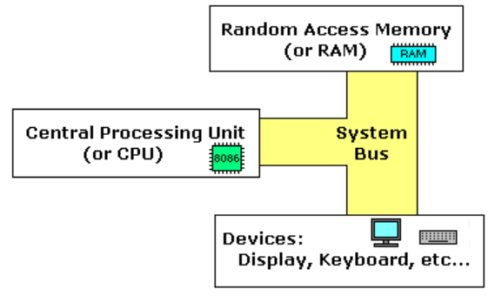
Computer Bus
Computer bus: A communication link (set of wires) used inside a computer to send data, addresses, control signals, and power to various hardware components
Buses connect various hardware components to each other
Main bus types: Connect CPU to RAM
Address bus: Used for specifying memory addresses for reading or writing of data (Unidirectional)
Data bus: Specifies data to be written or contains data that was read (Bidirectional)
Control bus: Used for passing control signals (Bidirectional)
Address bus + Data bus + Control bus = System bus

Slide 3
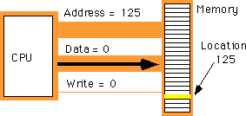
How is the System Bus Used?
Suppose the CPU wants to write a value of 0 in memory location 125
Address bus = Specifies the address of the memory location
Data bus = Specifies the data to be written
Control bus = Specifies the write operation

Slide 4
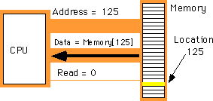
How is the System Bus Used?
Suppose the CPU wants to read data stored in memory location 125
Address bus = Specifies the address of the memory location
Control bus = Specifies the read operation
Data bus = Will contain the data read from memory location 125

Slide 5
Instructions
Data bus = Transfer data from the CPU to the main memory or from the main memory to the CPU
Remember, code is also in the main memory
CPU needs to fetch each instruction from the main memory and execute it
Which bus will be used to fetch the instructions from the main memory into the CPU?

Slide 6
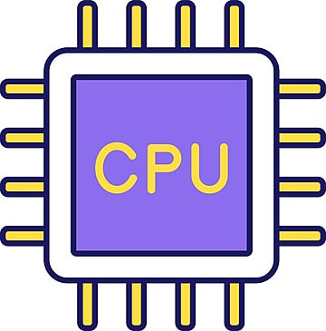
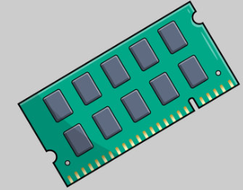
von Neumann versus Harvard Architecture
von Neumann Architecture
Single memory for data and instructions
Single bus
Simple, Inexpensive
Simultaneous multiple memory fetches not possible
von Neumann bottleneck: Separation of memory and data
Harvard Architecture
Separate memory and separate bus for data and instructions
Multi bus
Complex, Expensive
Simultaneous two memory fetches possible
Data and Instructions Bus
Data Bus
Instructions Bus

Slide 7
PCI Express
Earlier: Each component/device was connected to every other device using a separate wire (Point-to-Point connection)
Now: A common bridge connects various devices (Multi-Point connection)
Earlier Peripheral Component Interconnect (PCI)
Now PCI Express = Modern technique used for system bus
The CPU, memory, and cache are connected to a bridge chip
A switch is connected to the bridge
Each I/O chip has a dedicated point-to-point connection to the switch
Each connection consists of a pair of unidirectional channels, one to the switch and one from it
All the devices are treated equally
Works like a packet switching network

Slide 8
Point-to-Point versus Multi-Point Connection
Point-to-Point
Multi-Point
Device A
Device B
Device A
Device B
Device C
Device D
Device C
Device D

Slide 9
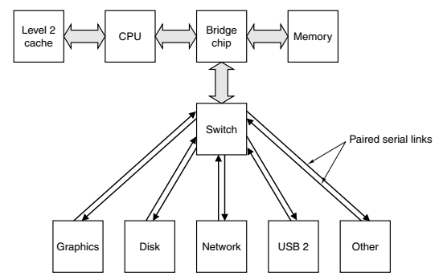
PCI Express

Slide 10
Inside the CPU

Slide 11
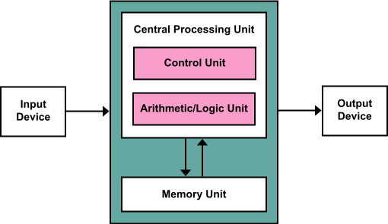
CPU Organization
CPU = CU + ALU + Registers
CU = Control Unit
ALU = Arithmetic and Logical Unit
Registers = Fast memory inside the CPU

Slide 12
Registers
Register: Fastest type of memory, because it is inside the CPU
Purpose: Perform all arithmetic and logical operations in a computer
The original Intel CPU had very few registers, e.g.
AX The accumulator register
BX The base address register
CX The counting register
DX The data register
IP Points to the next instruction to be executed (along with CS)
Flags Contains results of a comparison

Slide 13
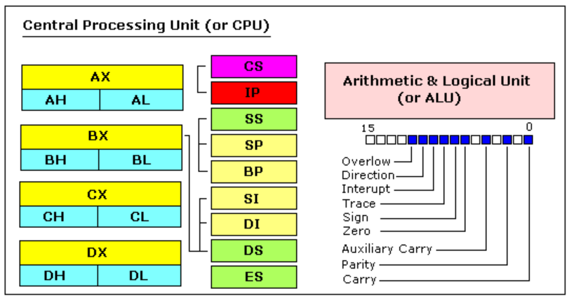
Registers in x86 CPU

Slide 14
Registers in x86 CPU
Size of each register = 16 bits
Four general-purpose registers (AX, BX, CX, DX) = Made of two separate 8-bit registers (high and low)
Example: If AX = 0011000000111001 then AH = 00110000 and AL = 00111001
Four segment registers: CS, DS, ES, SS
Code Segment (CS): Points to the segment containing the current program
Data Segment (DS): Points to the segment containing the data being used
Extra Segment (ES): To be used by the programmer as needed
Stack Segment (SS): Points to the segment containing the stack

Slide 15
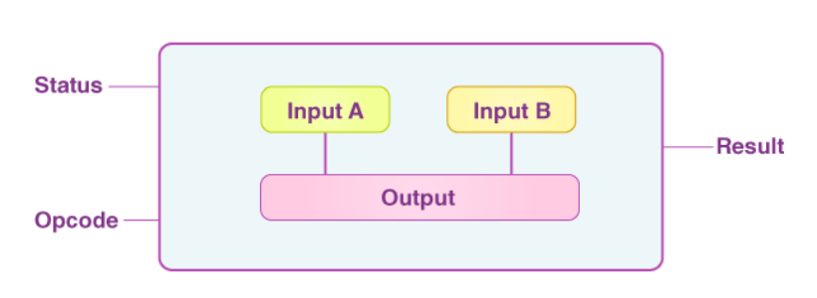
Arithmetic and Logical Unit (ALU)
Arithmetic and Logical Unit (ALU): Performs most of the operations
Example: Add 5 to the accumulator register AX:
Copy AX into ALU
Send 5 to ALU
Instruct the ALU to add these two values together
Move the result back into the AX register

Slide 16
Control Unit (CU)
Instruction Pointer (IP) or Program Counter (PC): Contains the address of the next executable instruction
Fetch instruction code (op code) from the memory using PC
Move the op code into the instruction decoding register (Instruction Register (IR))
Increment the value in IP/PC to get the next instruction after the current instruction is complete

Slide 17
Instruction Set Architecture (ISA)
Every CPU understands a fixed set of machine language instructions = Instructions set
Called Instructions Set Architecture (ISA)
Different CPU families (e.g. Intel, ARM) = Different ISA
Meaning: Intel CPU’s machine language ≠ ARM’s machine language

Slide 18
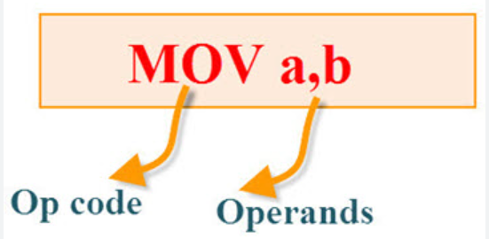
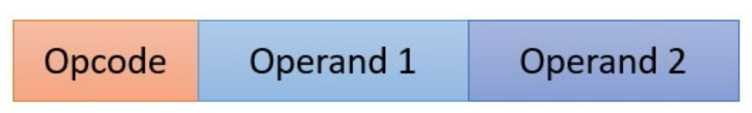
Op Code and Operands
Instruction: Also called as mnemonic has two parts:
Op code: Operation/instruction to be performed
Operand: Data/value/memory location on which the op code is going to work
Example: Add R1, R2
Add: Op code
R1 and R2: Operands
R2: Source, R1: Destination
R2: Will remain unchanged, R1: May get modified (if R2 is not 0)

Slide 19
Instruction Examples
mov reg, reg/memory/constant
mov memory, reg
add reg, reg/memory/constant
sub reg, reg/memory/constant
cmp reg, reg/memory/constant
and reg, reg/memory/constant
or reg, reg/memory/constant
not reg/memory

Slide 20
The ‘x86’ Architecture

Slide 21
Intel x86 Architecture – Basic Terms
x86: Instruction Set Architectures (ISA): Intel processors, 16-bit instruction set, later modified to 32-bit
x64: 64-bit architecture
Architecture | Meaning | Details about the name
x86 | 32-bit architecture | ‘86’ = Processor 8086
x64 | 64-bit architecture | ‘64’ = Number of bits

Slide 22
Intel x86/X64 Architecture – Understanding
X86
32-bit CPU = 32 wires between CPU and main memory (Address bus = 32 bits)
2^32 = 4,294,967,295
So, a 32-bit X86 processor can access ~4GB RAM locations
Also, at a time, 32 bits of data will be read from memory (Data bus = 32 bits)
X64
64-bit CPU = 64 wires between CPU and main memory (Address bus = 64 bits)
2^64 =18.4 exabyte memory locations can be accessed (See next slide)
Also, at a time, 64 bits of data will be read from memory (Data bus = 64 bits)

Slide 23
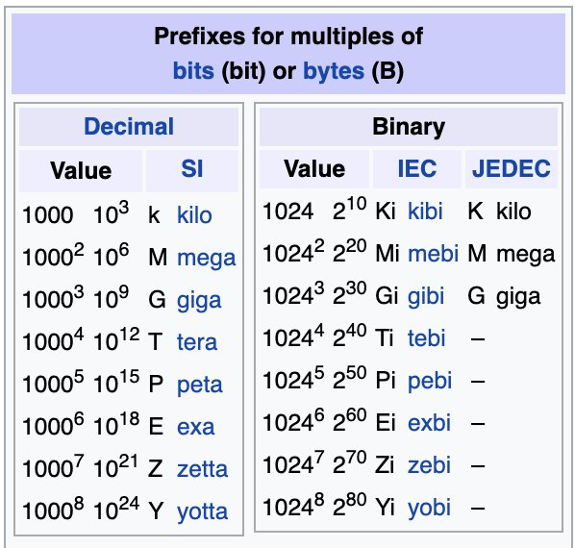
Measuring Bits-Bytes

Slide 24
Overview of x86 Data Types
Bit
1
Nibble
4
Byte
8
Word
16
Doubleword
32
Quadword
64

Slide 25
Ranges of Important Data Types
System | Range | Power of 2 | How many bytes?
Byte | 0-255 | 0 to 2⁸ - 1 | 1
Word | 0-65,535 | 0 to 2¹⁶ – 1 | 2
Doubleword | 0-4,294,967,295 | 0 to 2³² – 1 | 4
Quadword | 0-18,446,744,073,709,551,615 | 0 to 2⁶⁴ – 1 | 8

Slide 26
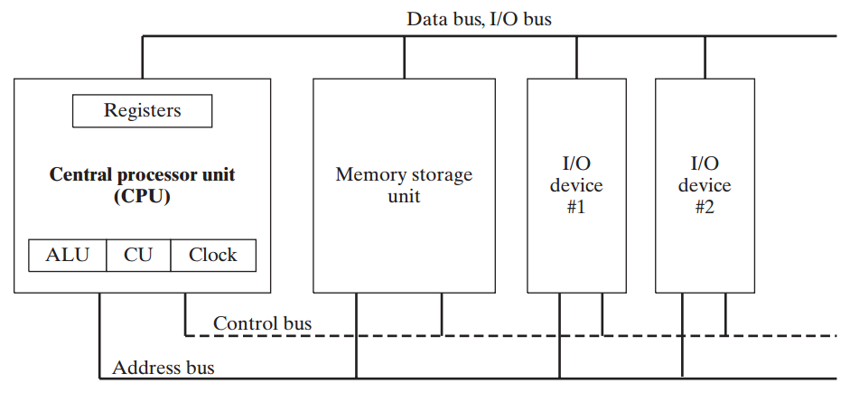
Basic x86 Microcomputer Design

Slide 27
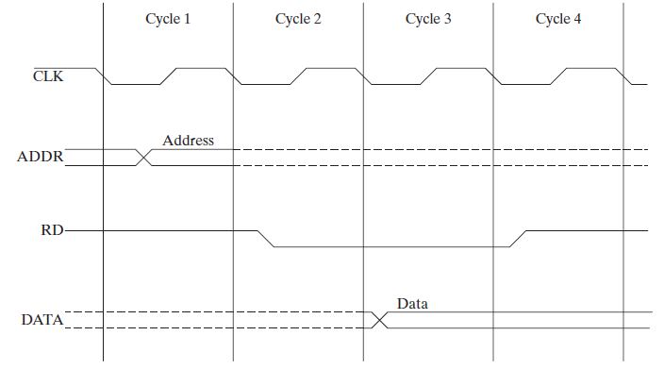
Reading from Memory: Clock Cycles
Cycle 1: Address bits of the memory bits are placed on the address bus
Cycle 2: Read line is set to 0 (Low) to indicate that this is a memory read operation
Cycle 3: CPU waits one cycle to give memory, time to respond
Cycle 4: Memory controller places the data and Read line becomes 1, to indicate to the CPU to read the data on the data bus

Slide 28
Addressing Modes

Slide 29
Addressing Modes
Addressing mode: Decides how to identify the operands
Types: Register, Immediate, Direct, Indirect, Indexed
Allows more flexibility to the programmer, since the operands can be in the registers, memory, or in a memory location pointed to by another memory location
Drawback: More complexity in instructions

Slide 30
Register Addressing Mode
Register addressing: Operands are in the CPU registers
Example: add ax, bx
Fastest
Problem: Upper limit based on number of registers
Program to add two numbers
mov ax, 03h
mov bx, 05h
add ax, bx

Slide 31
Immediate Addressing
Immediate addressing: Operand is a constant
Example: add ax, 25
No memory access needed
Limited use
Program to add a constant to a register that already contains some value
mov ax, 03h
add ax, 05h

Slide 32
Direct Addressing Mode
Direct addressing: Operand’s memory address is used
Example: mov ax, [1000]
Simplest
Limited by register and memory size
Program to add a value stored at memory address 1000 into a register
mov ax, 03h
mov [1000h], 05h
add ax, [1000h]

Slide 33
Indirect Addressing Mode
Indirect addressing: Actual value is at a memory address, and address value is in a register
Example: mov ax, [bx]
Complex and slow
Program to read the value at a memory address stored in a register
mov ax, 03h
mov [1000h], 05h
mov bx, 1000h
add ax, [bx]

Slide 34
Indexed Addressing Mode
Indexed addressing: Actual value is at a memory address, and address value plus an index is in a register
Example: mov ax, [1000+bx]
Use: Arrays, pointers, records, and other data structures

